Slide 1
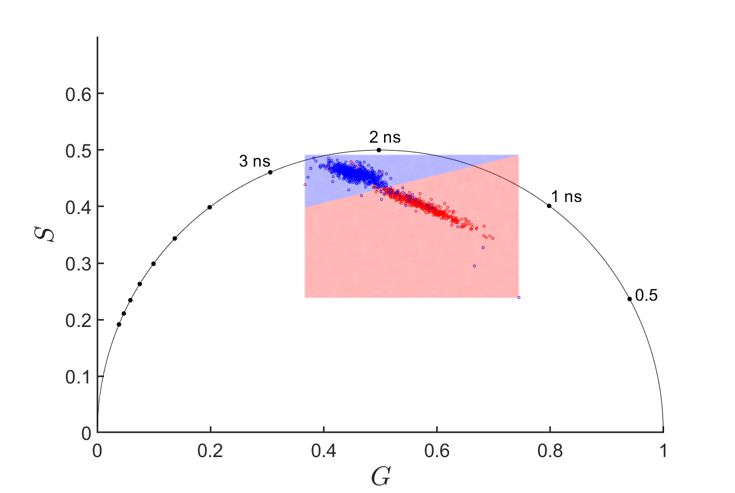
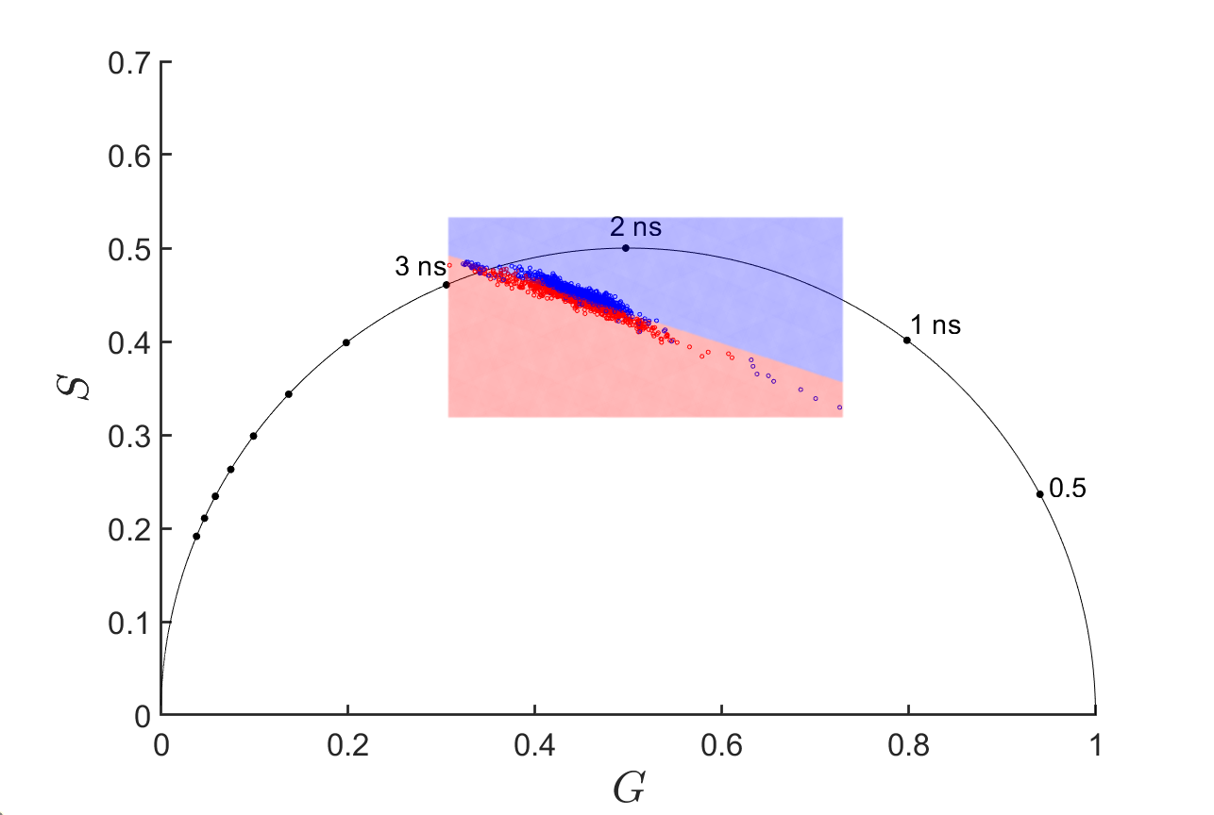
A
B cells NAD(P)H
CD69+
CD69-
B
B cells
206 | 19
21 | 415
C
NK cells NAD(P)H
CD69+
CD69-
D
NK cells
324 | 66
28 | 452
E
NAD(P)H
NK cells
B cells
F
80 MHz
Lymphocyte subtype
160 MHz
662 | 1
1 | 868
FAD
NK cells
B cells
80 MHz
160 MHz
Notes:
Supplemental Figure 9. Phasors

